Slide 1
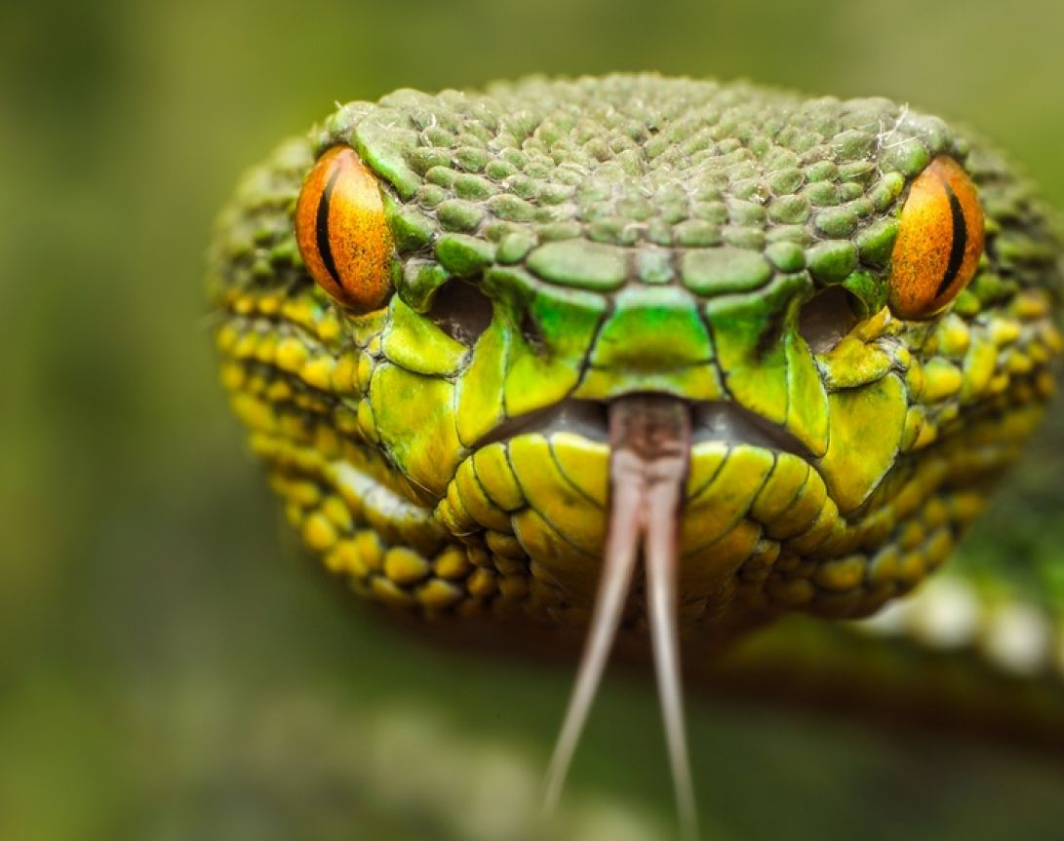
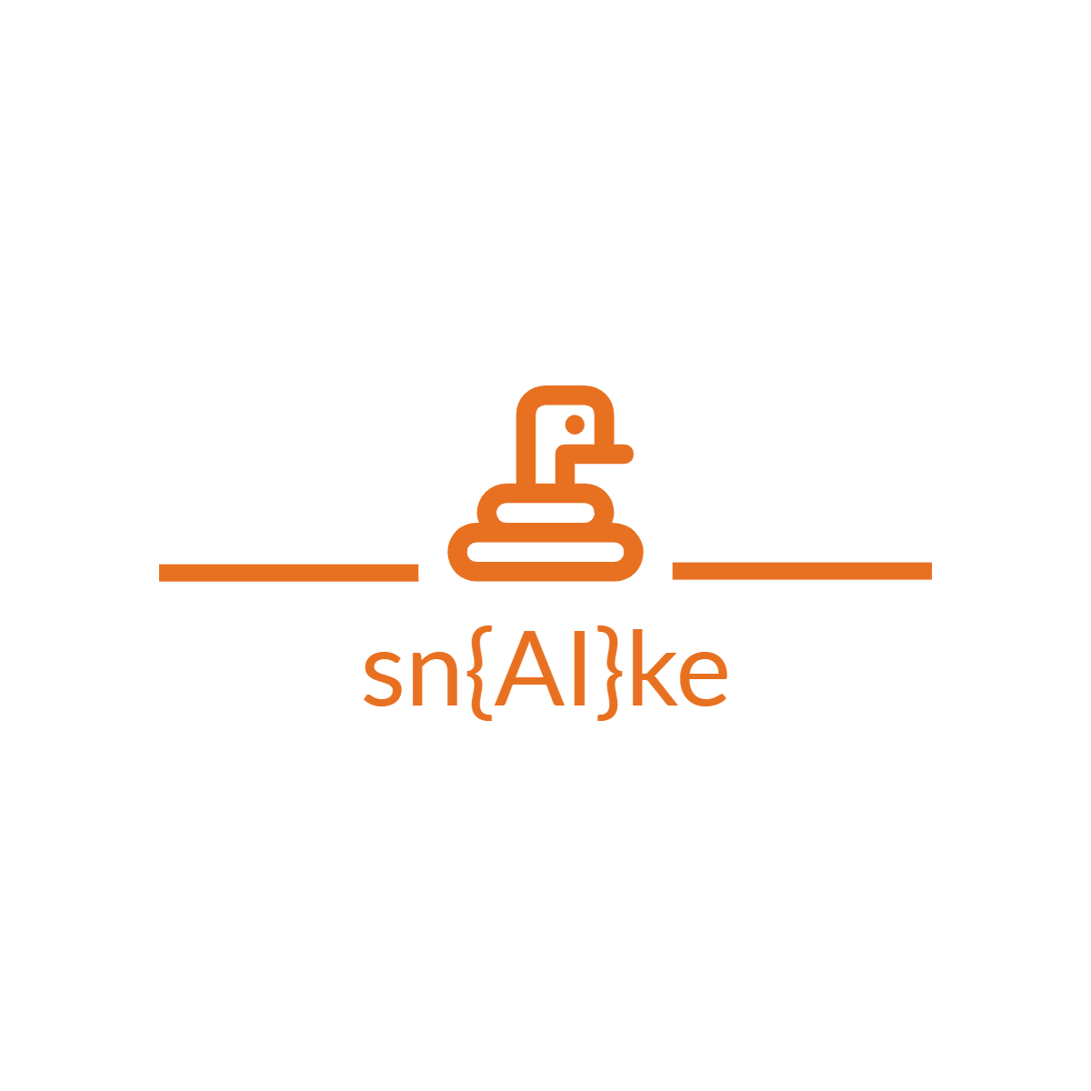
SnakeTeam
When a snake bite, we save your life.

Slide 2
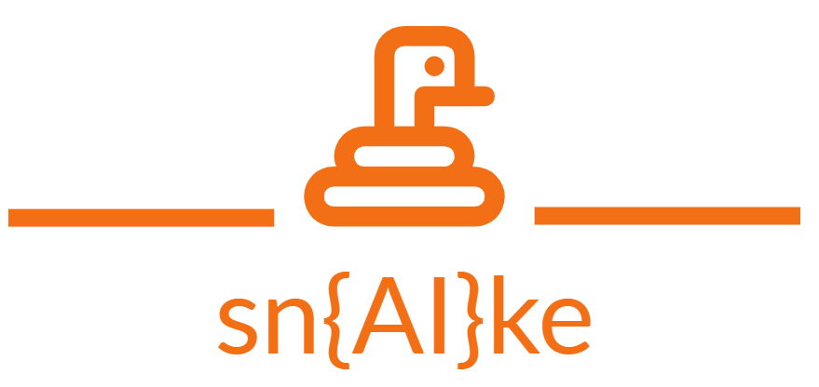
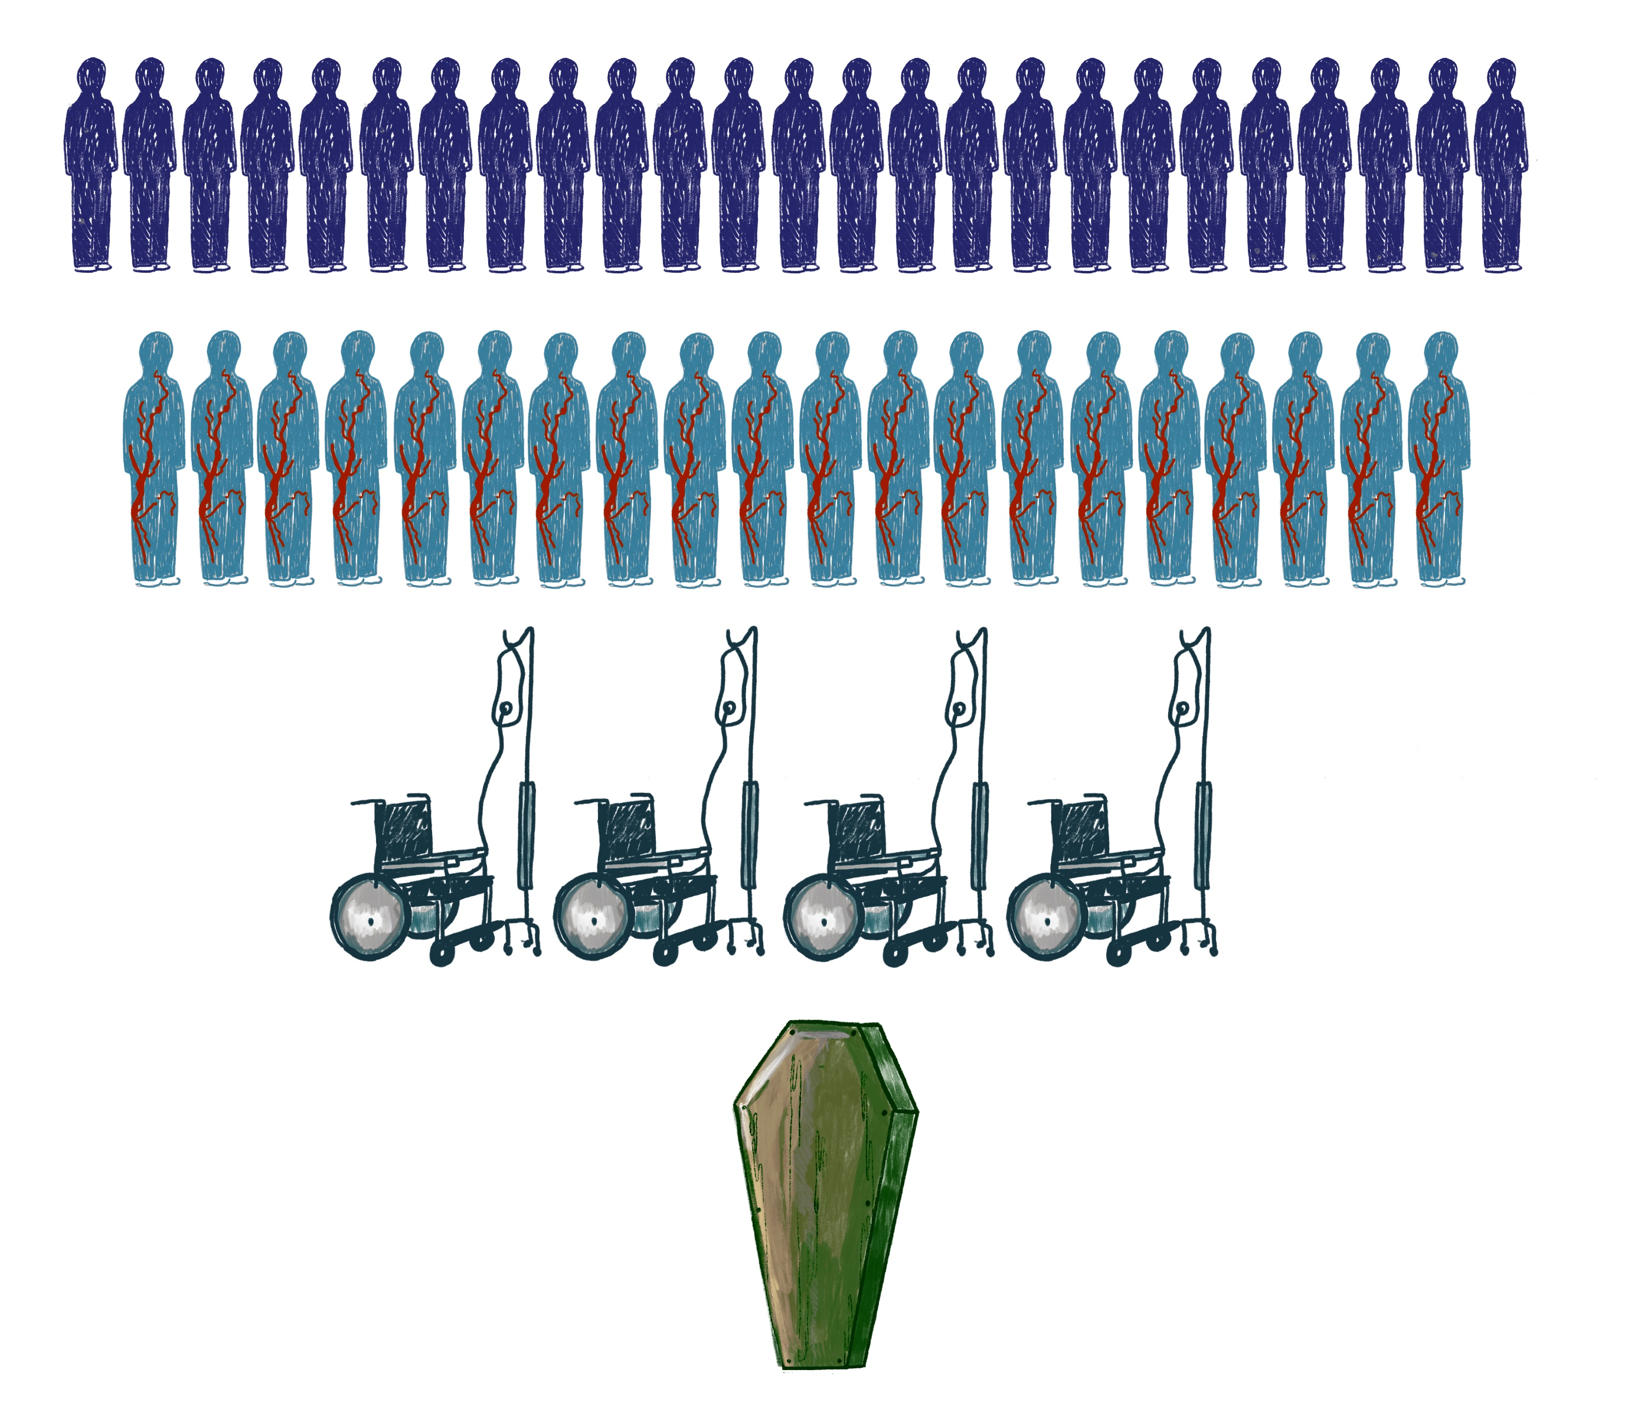
Problem
Every 5 minutes
50 people will be bitten by a snake,
25 will be injected with venom,
4 will be permanently disabled,
1 will die.
ca. 15 people/hour die from snakebite in the world (WHO, 2021)
Source: https://storymaps.arcgis.com/stories/20d04a1d369444599e9971167befa7a8 (01/04/2022)

Slide 3
International health framework
Problem
After bite, treatment must be done within 30 minutes after the bite.
Victim must be immediately transported to the hospital and take the snake with her for identification (dead or alive).
Species identification is usually difficult and treatments are most of the times dictated after toxins analysis.
In most cases, the bite site should not be tampered with until full identification of toxins, even if it might could help the victim and reduce her pain.
30 minutes …
… is how long a biten person has to be administred an antivenom!
Victim must be immediately transported to the hospital and take the snake with her for identification (dead or alive).
Species identification is usually difficult and treatments are most of the times dictated after toxins analysis.
In most cases, the bite site should not be tampered with until full identification of toxins, even if it might could help the victim and reduce her pain.
Moreover …
WHO has the objective to reduce mortality and disability from snakebite envenoming by 50% before 2030.

Slide 4
Venomous Snakes
From a total of approx. 310 venomous snakes, the most abundant and dangerous are:
King cobra
Common krait
Russell's viper
Indian cobra
Saw-scaled viper
Monocled cobra
Ophiophagus hannah
Bungarus caeruleus
Daboia russelii
Naja naja
Echis carinatus
Naja kaouthia
Source: https://www.who.int/teams/control-of-neglected-tropical-diseases/snakebite-envenoming/snakebite-information-and-data-platform

Slide 5
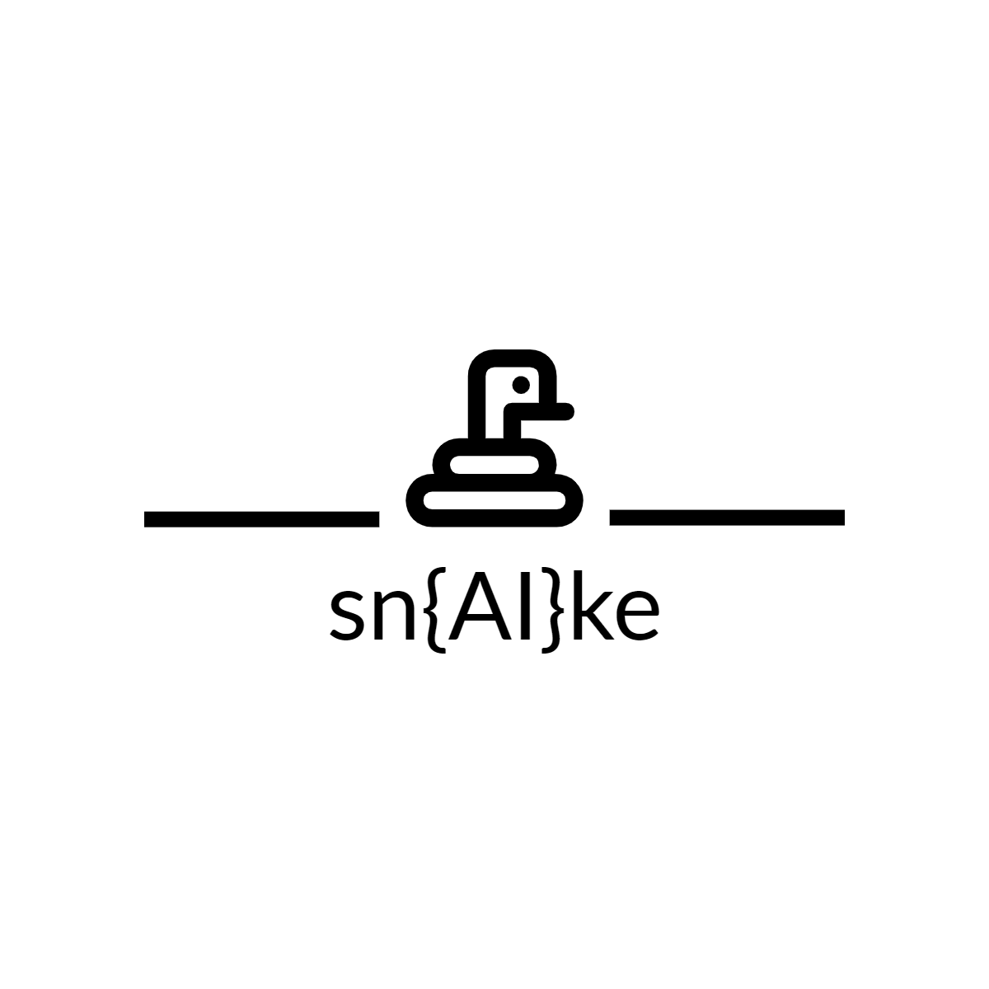




Solution
Mobile APP – sn{AI}ke:
Snake species identification via image-based AI algorithm
Inputs:
Location
Photo
Region-specific Networks for snake species identification:
Indochina, Australia, Africa, Americas
When a snake bite, we save your life
Your location is here
Shoot your Snake
Your latest Snakes

Slide 6
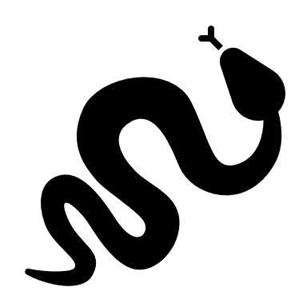
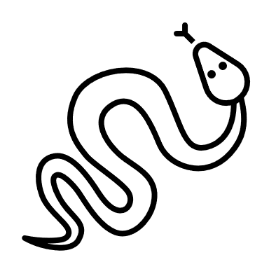
Solution
Mobile APP – sn{AI}ke:
Returns:
Common Name
Scientific Name
Adjusted Antivenoms
Dangerousness Index
Bite Site Location + User Data
Share Info with local SOS teams
When a snake bite, we save your life
Common Name: Indian cobra
Scientific Name: Naja naja
Venomous: YES
Antivenoms: Snake Venom Antiserum I.P.
Polyvalent Anti Snake Venom Serum
Snake Venom Antiserum (Polyvalent)
Polyvalent Snake Antivenin (Asia)
Snake antivenin I.P. (Asia)
Dangerousness: 4 [scale 0-5]
Bite site: Calcutá, India
SOS

Slide 7
Target User
Local Inhabitants
Tourists
Local Health System / Government
Market
Southeastern Asia Market + Indian Market

Slide 8
Advantages
In-situ identification of snake species by photo:
Avoid having to catch, kill or carry the snake
Instant determination of attacking species and venom
Assertment on First Aid procedures
Instant determination of appropriate anti-venom
Possible communication with local SOS teams and hospitals:
Administration preparations are taken earlier
Reduce the timelapse between bite and anti-venom administration
Avoid time waste and displacements to nearby hospital, as SOS teams can carry the correct antivenom to the victim

Slide 9
Venomous Snakes
Images
Ophiophagus hannah (king cobra):
https://github.com/arjun921/Indian-Snakes-Dataset/tree/master/Venomous/King%20Cobra
Bungarus caeruleus (Common krait):
https://github.com/arjun921/Indian-Snakes-Dataset/tree/master/Venomous/Common%20Krait
Naja kaouthia (Monocled cobra):
https://github.com/arjun921/Indian-Snakes-Dataset/tree/master/Venomous/Monocled%20Cobra
Daboia russelii (Russell's Viper):
https://github.com/arjun921/Indian-Snakes-Dataset/tree/master/Venomous/Russell's%20Viper
Echis carinatus (Saw-scaled Viper):
https://github.com/arjun921/Indian-Snakes-Dataset/tree/master/Venomous/Saw-scaled%20Viper
Naja naja (Spectacled Cobra):
https://github.com/arjun921/Indian-Snakes-Dataset/tree/master/Venomous/Spectacled%20Cobra
https://bdj.pensoft.net/article/34013/instance/5004698/
Venoms & Anti-venoms
https://www.who.int/teams/control-of-neglected-tropical-diseases/snakebite-envenoming/snakebite-information-and-data-platform
http://www.toxinology.com/fusebox.cfm?fuseaction=main.snakes.search
http://tropicalpharmacology.com/tools/snake-venomics-display/
http://tropicalpharmacology.com/tools/stab-profiles/

Slide 10
Challenges
Train several networs / globe region
Segmetation - Distinguish and Identify the object “Snake” from images background
Use non-venomous or other snakes as interferents in test samples?
Notes:
Segmentation -> Yolov5

